Slide 1

Semantic Portals for Environmental Decision Support
Alejandro Llaves
Institute for Geoinformatics, Münster
Notes:
ENVISION is a FP7 European project which started the last month of January. Its name stands for Environmental Services Infrastructure, as you can see in the title.

Slide 2
Outline
ENVISION background
Mission
Goals
Use cases
Approach
General scenario

Slide 3
ENVISION Background
Follow-up of SWING
  Infrastructure for semantically decision support making
  http://www.swing-project.org
FP7 project (started January 2010)
Notes:
The ENVISION project is the follow-up of the SWING project, adopting and extending its results.

Slide 4
Mission
Support non ICT-skilled users in the process of semantic discovery and adaptive chaining and composition of environmental models as web services

Slide 5
Goals (re-format)
Open Source
Community building
Contribution to SEIS, SISE, INSPIRE
Notes:
1. OPEN SOURCE: …
2. COMMUNITY: …
It provides an ENVIronmental Services Infrastructure with ONtologies that aims to support non ICT-skilled users in the process of semantic discovery and adaptive chaining and composition of environmental services.
3. INITIATIVES: he Shared Environmental Information System (SEIS) is one of the major initiatives taken by Europe to collect and share environmental information for the benefit of the global society.
INSPIRE is now a legal instrument that will enable an infrastructure for spatial information in Europe, to the benefit of environmental policies. The current agenda and organisation developed concerning the specification of INSPIRE data themes, a vital component of the implementing rules, is an opportunity that ENVISION has to take.
In addition to these clear contributions to SEIS and INSPIRE, ENVISION will also meet the challenge of the Single Information Space in Europe for the Environment (SISE), in its enablement of thematic tools and systems (service chaining, sensors) allowing a collaborative Information Space on the Web.

Slide 6
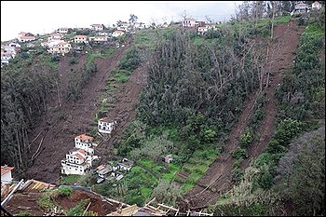
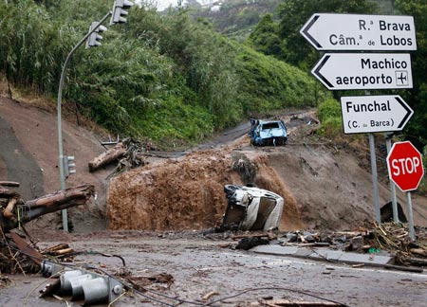
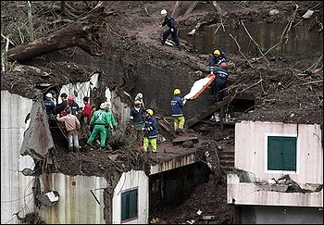
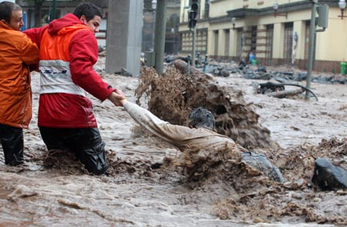
USE CASES
Landslides hazard and risk assessment
Notes:
Here we have a selection of some recently pictures taken in the Island of Madeira (Portugal), during-and after the last floods. As you know, intensive floods usually cause debris and mud flows, like in Madeira.
Global warming is thought to have an increasing influence on natural events and the occurrence of natural dangerous phenomena such as hurricanes, storms and depressions responsible for damage to the environment through: floods, cyclonic swell, storm tides and coastal erosion.
Heavy rainfall can also create or trigger potentially-damaging events such as mud flows, landslides and ground failure. As an example of a geographical area where these events are common and where much data and sensors are available, we have chosen a French department (Guadeloupe) as a pilot area (although many of the problems addressed in this pilot use case are general) to point out some of the problems ENVISION is targeting.

Slide 7
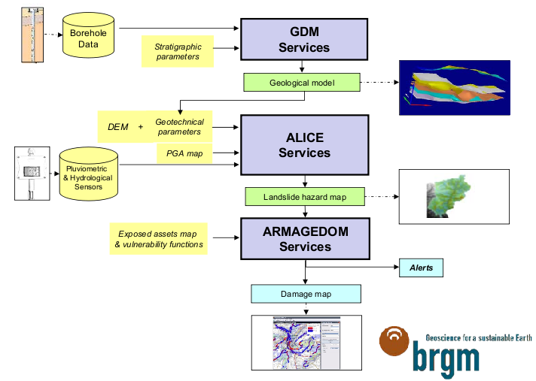
Notes:
The landslide experts in Envision project are the French guys from BRGM. At this moment, they are working on modeling the phenomenon. So this is one of the proposals.
The main services here are GDM, ALICE and ARMAGEDOM.
The GDM service for ENVISION landslide pilot case is a function which interpolates borehole data (logs) to build a geological model.
ALICE is a landslide hazard assessment tool based on 2D ground stability calculation.
ARMAGEDOM is a software designed to simulate potential damage caused by a dangerous event.
The French Geological Survey (BRGM) has a regional office on Guadeloupe, at which there are many databases available concerning landslides and earthquakes. In addition, this regional office has installed many in-situ sensors in the pilot area.
The aim of the ENVISION use-case for Guadeloupe is to set up Web services that can be manipulated by non-technical operators and can simulate damage under different climatic and/or earthquake (another potential trigger for landslides) scenarios.
With the help of the ENVISION framework, standalone applications as GDM, ALICE, ARMAGEDOM, initially with restricted connection to limited data format and no interoperability, will be provided to a much wider community in a very flexible way, allowing the different components to be reused in many ways, and connected to different data sources as WFS or SOS.

Slide 8
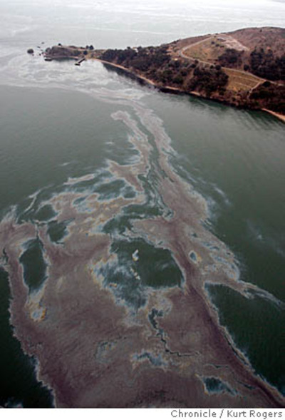
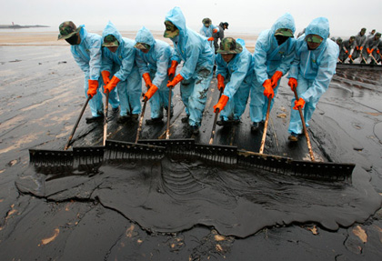
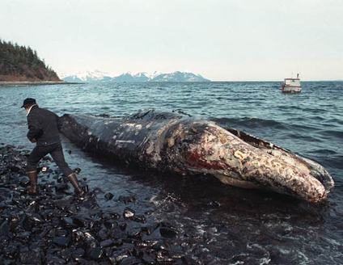
USE CASES
Oil spill risk analysis
Notes:
Accidental oil discharges do happen and may potentially severely harm the natural environment. Oil spills at sea call for a quick and adequate response in order to minimize biological consequences. Knowledge about the behaviour of oil spills is crucial for taking adequate response actions.

Slide 9
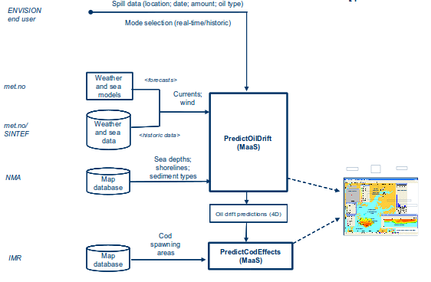
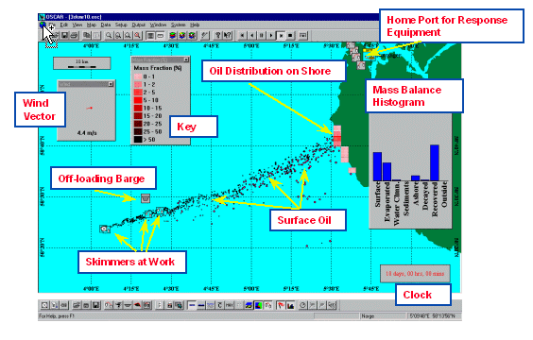
Notes:
In this case, the field experts work at SINTEF Materials & Chemistry, department of
Marine Environmental Technology, in Trondheim.
This is the model they are working on, which includes the following innovations respect the previous one:
- Spill data entered by user (instead of satellite link)
- Support for both real-time and historic modes
- A (simple) PredictCodEffects MaaS can be built to demonstrate model chaining
Where we see the label MaaS, there were a chain of services (Oil Weathering – OWM and Oil Drift – OSCAR) which will be chained to create a Model-as-a-Service in the Oil Spill domain.
OSCAR – Oil Spill Containment And Response

Slide 10
OUTLINE
ENVISION background
Mission
Goals
Use cases
Approach
General scenario

Slide 11
APPROACH
Methods
  On-the-web enabling and packaging of technologies
  Model-as-a-Service (MaaS)
  Use of data streaming information for:
    Dynamic building of ontologies
    Adaptive service execution
Notes:
Innovations in ENVISION are:
1. On-the-Web enabling and packaging of technologies for their use by non ICT-skilled users.
2. Support for migrating environmental models to be provided as models as a service (Maas).
3. the use of data streaming information for harvesting information for dynamic building of ontologies and adapting service execution.

Slide 12
APPROACH
MaaS = Model Web + SaaS
  Many current environmental models
    monolithic and isolated applications
    manual handling
  Concept of the Model Web (GEOSS)
  Automated request system for model runs with visualization and analysis tools and through standard data formats for simulation data interoperability.
Notes:
The Model-as-a-service (MaaS) concept has evolved as a merge of the Model Web and Software-as-a-Service (SaaS), in the context of the current Everything-as-a-service, as a concept of being able to call up re-usable, fine-grained software components across a network.
The MODEL WEB is defined as an approach to manage models on the web.
1 STATE OF THE ART: Many current environmental models are provided through monolithic and isolated apps, only linked by manual handling of input and output files and interactive data entry.
2 CHALLENGES: In the evolution towards SISE/SEIS, it is a goal that not only data become available, but also a large number of environmental models become available as services → MaaS
3. VISION: The aim here is to provide access for the scientific community to modern space research model through an automated request system for model runs, with modern, online, visualization and analysis tools and through standard data formats for simulation data interoperability.
It is important to mention that the provision strongly depends on the flexibility, which should be allowed, both in respect to provided data and to changing model parameters. Many models are closely related to the underlying data and providers are often not willing to provide data access.

Slide 13
Approach
MaaS - OGC perspective
  Closed models
    migrated as a whole into the Web
    access to input data and boundary conditions are hard-coded
    valid for specific problems
  Open models
    model partition: data sources or processes
    each module published as a Web Service
    service composition to represent original workflow
    adaptable to different geographic regions
Notes:
We distinguish between 2 options to publish computer models as a service:
CLOSE MODELS: Existing models can be migrated as a whole into the Web. The access to input data as well as the boundary conditions, are then hard-coded in the model code.
OPEN MODELS: Or they are partitioned into individual models (representing either data sources or processes), with each module published as Web service on its own. Service compositions are then used to represent the original model workflow, and are themselves accessible as Web service.

Slide 14
Approach
MaaS - OGC perspective
  Closed models
    OGC solution: SOS
    Input: no model parameters, but spatial/temporal extent
    Output: O&M including WFS/WCS
  Open models
    OGC solution: SPS
    Input: model parameters
    Output: reference to WFS/WCS
Notes:
CLOSED MODELS: Here, the user is not supposed to specify the model parameters. Instead, only standard parameters like the maximum spatial and temporal extent can be defined. Since the result is encoded in O&M, necessary meta-information such as model parameters or quality information can be listed here. The resulting data is not directly included. Depending on whether the output is a feature (collection) or coverage, a reference to a WFS or Web Coverage Service (WCS) is included in the O&M response.
OPEN MODELS: Users have to specify parameters for open models. The SPS specification provides a common way to define model parameters and also offers asynchronous communication. This enables notification once the model has computed the output. Similar to the proposal for closed models, the execution via a SPS interface results in a reference to a WFS/WCS serving the actual result. This enables caching and reuse of already produced outputs. Additionally, it eases the integration of the model results at the interfaces are already supported by many client applications. We have to understand the user's expectations for accessing a model in the Web to understand the choice for SOS/SPS coupled with a WFS or WCS. Even though a WPS could be used as well, this standard is too vague regarding the semantics of the output.
OPENS ISSUES: Several other open issues have to be further investigated to enable seamless migration of existing environmental model into the Web. Sensor observing real-world geoprocesses and events are inherently related to environmental models. Both result in observations of real world geoprocesses. Ontologies capturing the dynamics of geographic space can establish a link between sensors and models, with the ultimate goal to seamlessly switch between both. The quality of the resulting information, in particular its uncertainty, has to be considered before integrating models in potentially critical applications. And in the end, the user has to be aware of the model, its uncertainty, and the underlying assumptions. A user should be able to evaluate the resulting data, starting from the selected data sources and calibrating parameters, a description of the chosen algorithm, to the quality of produced result.

Slide 15
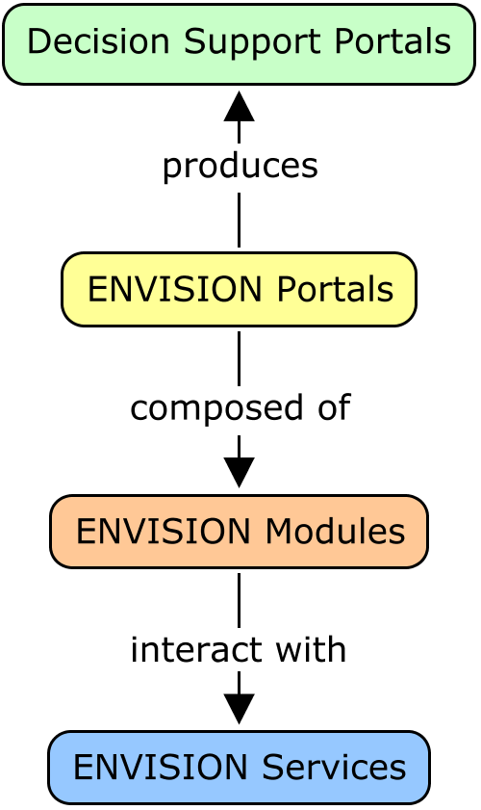
APPROACH
Architecture (high level)

Slide 16
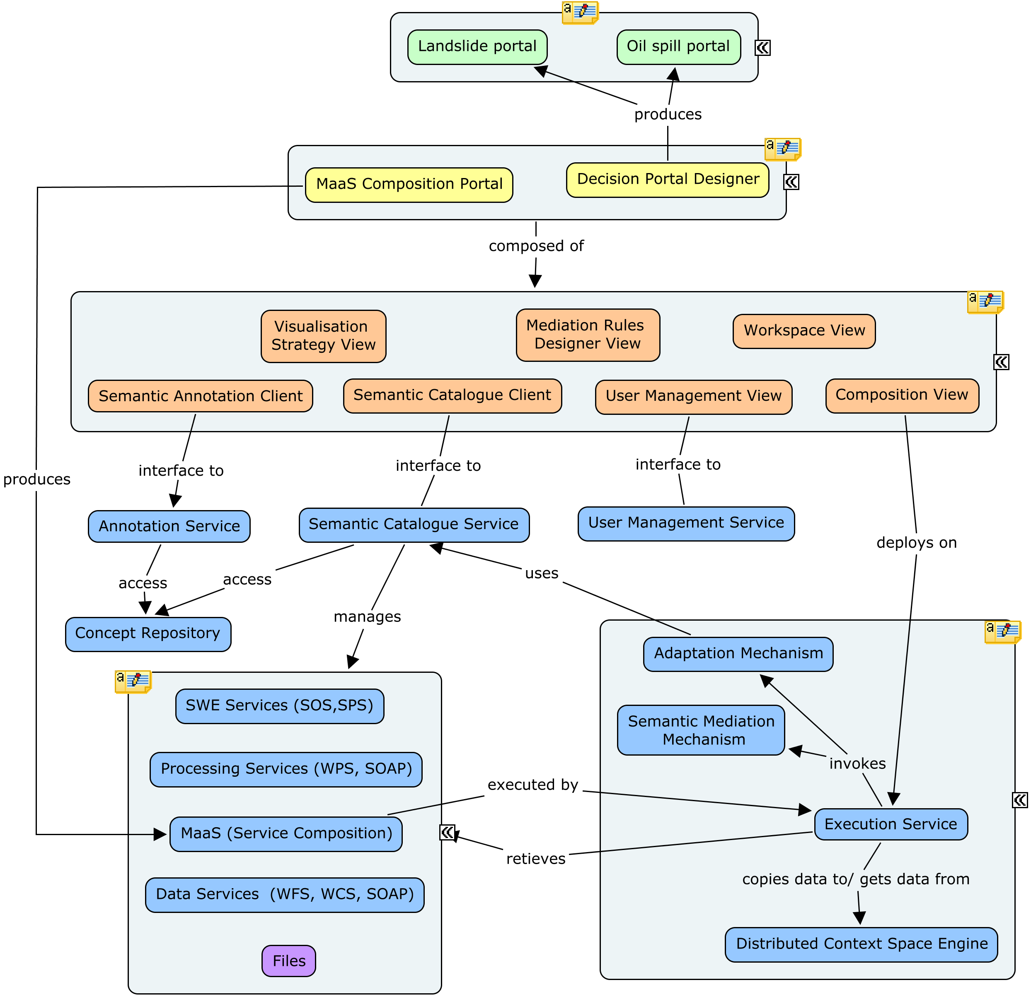

Slide 17
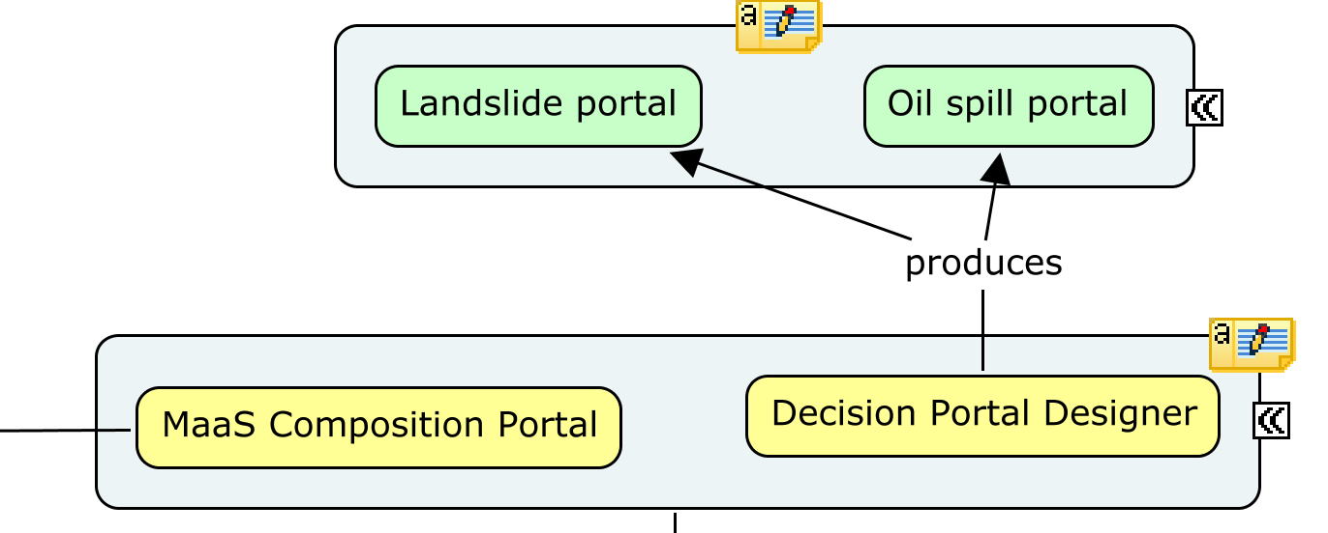
Architecture (top)

Slide 18
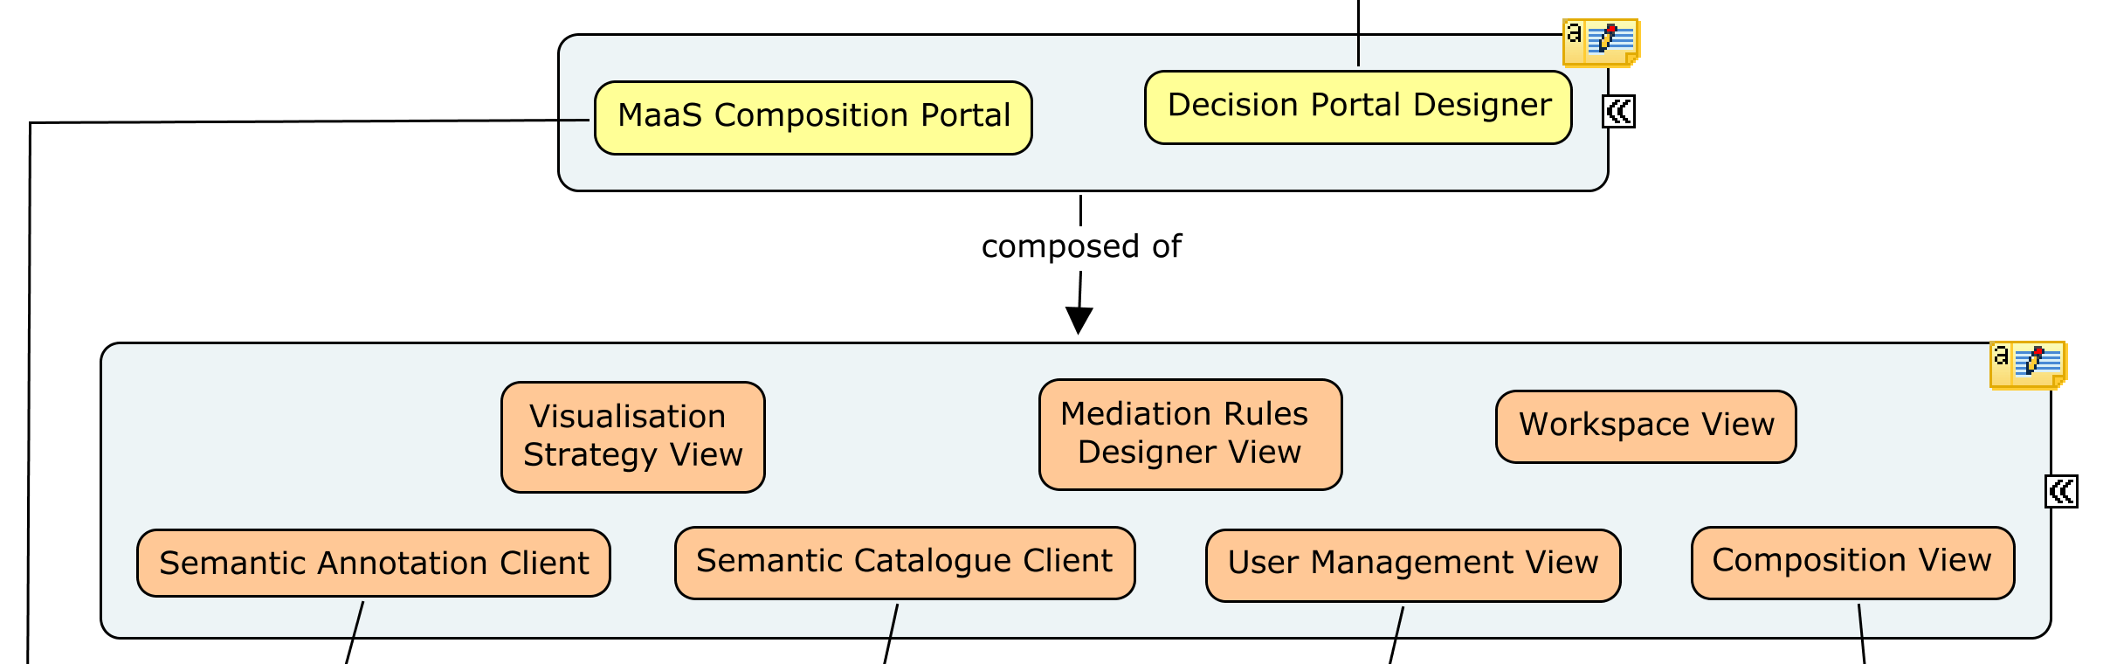
Architecture (middle)

Slide 19
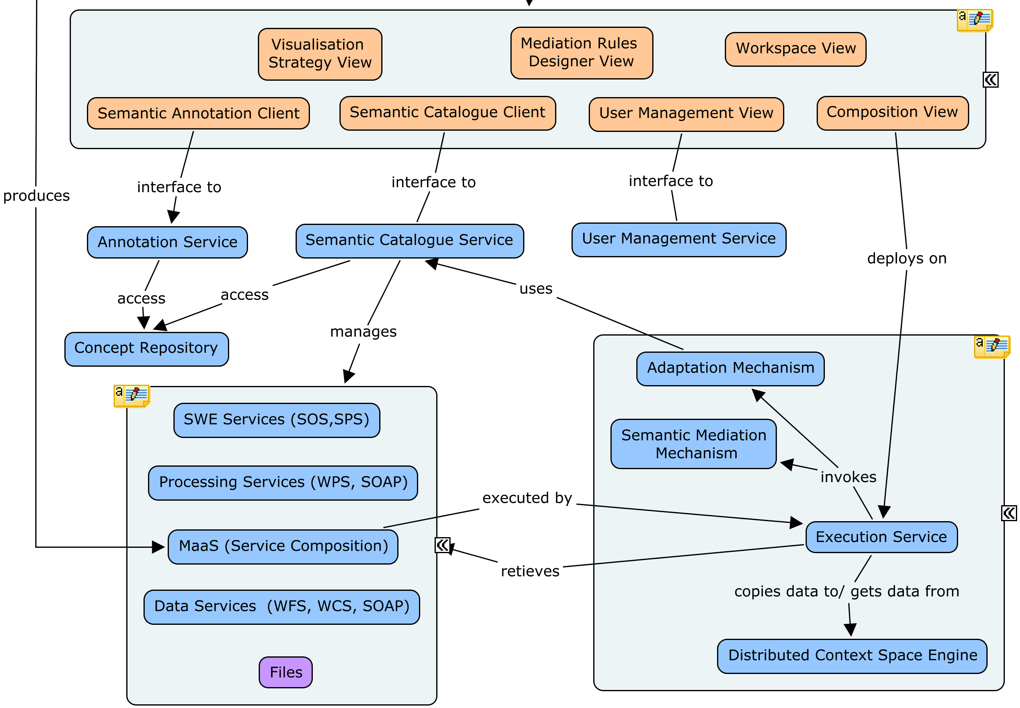
Architecture (bottom)

Slide 20
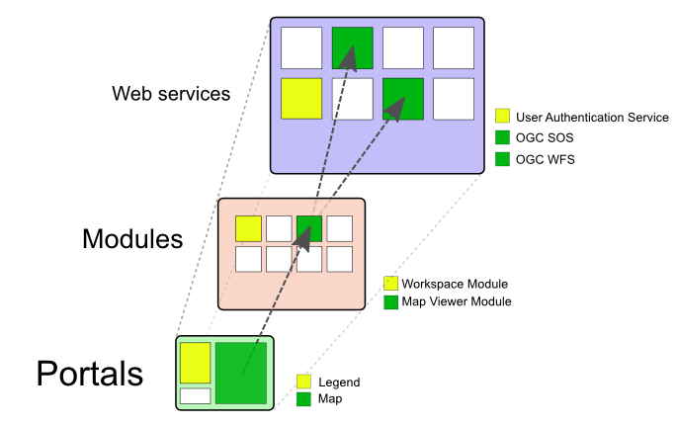
Architecture (layers)

Slide 21
OUTLINE
Background
Mission
Use cases
Approach
General scenario

Slide 22
GENERAL SCENARIO
User profiles
  Model design
    Discover existing resources
    Build the modeling workflow
    Register/Annotate the new service
Notes:
Depending on the users’ profiles, the different actors may interact in different ways: at design time, to provide on-the-shelf modeling solutions, at set up time, to connect the appropriate sources of information to feed the ad-hoc modeling service, and at run time to interact with the information provided by the models and to monitor the system.
Design time user operations
Discover existing re-sources: Iteratively, the user formulates semantic queries using the graphical interface, to find appropriate services. These queries are sent to the catalogue. The catalogue sends back all the resources matching the queries.
Build the modeling workflow: The user graphically composes a service workflow based on the identified resources. This model can be connected either with full static information from databases for simulation purposes; or real-time sensors.
Register/Annotate the new Service: The resulting service is deployed and registered in the catalogue and annotated using the relevant ontologies.
Set-up time user operations
Discover existing Modeling Services: The user query the catalogue for existing modeling services. The catalogue sends back all modeling services available.
Select a region of interest (ROI): The region of interest is graphically selected.
Discover existing data sources: The catalogue sends back all data sources in compliance with the modeling service input parameters.
Select the data sources: The user selects data relating to boreholes (or oil spill).
Set the parameters.
Play the scenario: The user runs the scenario and retrieves a stability modeling data space.

Slide 23
GENERAL SCENARIO
User profiles
  Portal design
    Discover existing modeling services
    Select a Region Of Interest
    Discover existing data sources
    Select the data sources
    Set the parameters
    Play the scenario
Notes:
Depending on the users’ profiles, the different actors may interact in different ways: at design time, to provide on-the-shelf modeling solutions, at set up time, to connect the appropriate sources of information to feed the ad-hoc modeling service, and at run time to interact with the information provided by the models and to monitor the system.
Design time user operations
Discover existing re-sources: Iteratively, the user formulates semantic queries using the graphical interface, to find appropriate services. These queries are sent to the catalogue. The catalogue sends back all the resources matching the queries.
Build the modeling workflow: The user graphically composes a service workflow based on the identified resources. This model can be connected either with full static information from databases for simulation purposes; or real-time sensors.
Register/Annotate the new Service: The resulting service is deployed and registered in the catalogue and annotated using the relevant ontologies.
Set-up time user operations
Discover existing Modeling Services: The user query the catalogue for existing modeling services. The catalogue sends back all modeling services available.
Select a region of interest (ROI): The region of interest is graphically selected.
Discover existing data sources: The catalogue sends back all data sources in compliance with the modeling service input parameters.
Select the data sources: The user selects data relating to boreholes (or oil spill).
Set the parameters.
Play the scenario: The user runs the scenario and retrieves a stability modeling data space.

Slide 24

GENERAL SCENARIO
User profiles
  Decision support
    Select a Region Of Interest (panning, zooming)
    Select notification strategy
Notes:
Execution time user operations
Select a region of interest (ROI): The region of interest is graphically selected.
Discover existing data sources: The catalogue sends back all data sources in compliance with the modeling service input parameters. In our case, some sensors are discovered.
Select the appropriate sensors data streams: The available sensors are connected to the MaaS.
Select functional parameters for the alerting system: The user selects the parameters to be triggered and threshold. The alerting mechanism is defined (e.g. send an e-mail to X When Y).

Slide 25
MORE INFORMATION...
http://www.envision-project.eu

Slide 26
Questions?

